Slide 1


ATM WITH CHATBOT INTERFACE USING GUI
Efforts By-VEDANT MALHOTRA(23CSU339)
DHYANESH SHARMA(23CSU100)
VIRAJ YADAV(23CSU346)

Slide 2
INTRODUCTION
……………………………………………………….

Slide 3
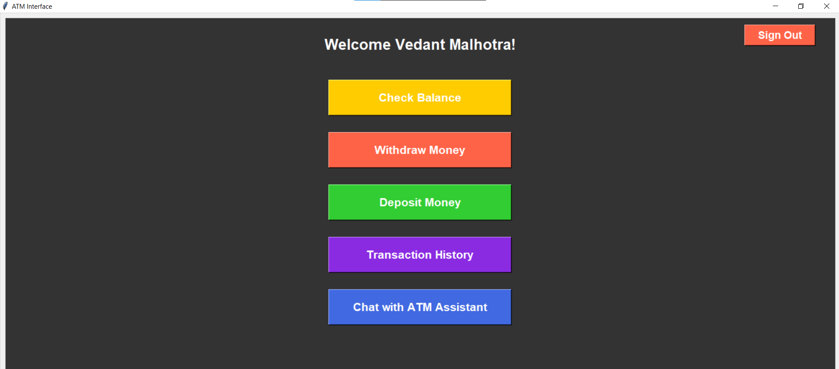
-------------------
What is an ATM?
Automated Teller Machine (ATM) allows customers to perform financial transactions such as withdrawals, deposits, and balance inquiries.
Current ATM User Interface
Standard PIN entry, transaction selection using buttons, and printed receipts.

Slide 4
FEATURES OF THE CODE
1.Log in validation upon entry
2.Interactive Gui for buttons etc
3. chat assistant for bank related queries
4. Atm Operations (Deposit , withdraw , checkbalance)
5. Transcation history Using Json

Slide 5
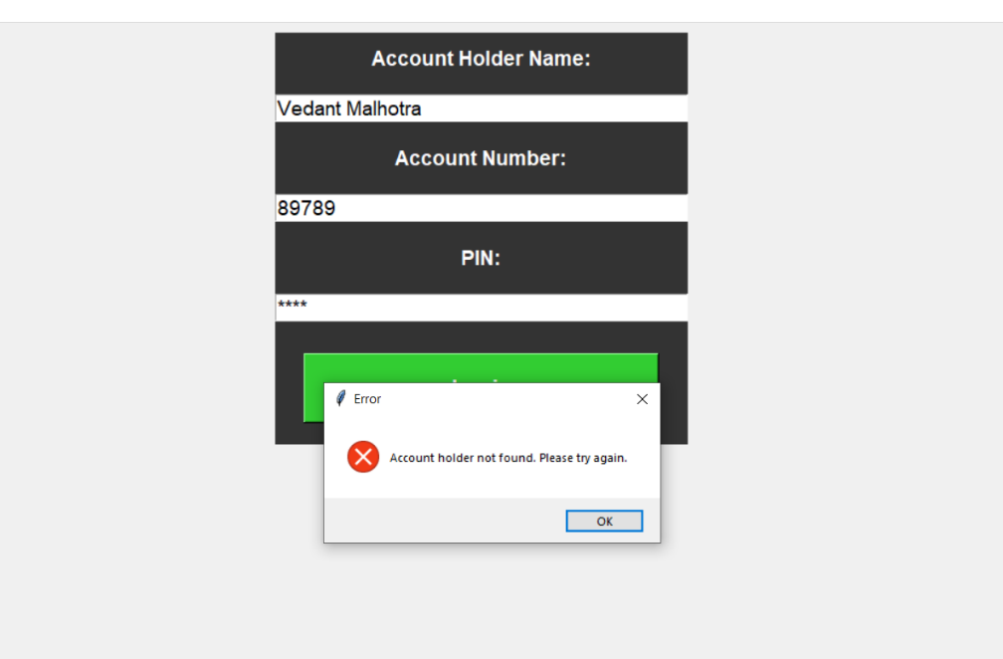
Details Validation
User details, including name, account number, and PIN, are checked against a JSON file (account_database.json).
Validation ensures the account exists and the PIN matches. Invalid inputs prompt error messages.

Slide 6
gui
GUI stands for Graphical User Interface. It is a type of user interface that allows users to interact with electronic devices using graphical icons, visual indicators, and other interactive elements like buttons, windows, and menus, rather than typing text-based commands.

Slide 7
GUI INTERFACE
Login Screen:
Enter PIN via a text box or voice recognition.
Main Menu:
Text-based buttons for transaction options (withdrawal,deposition, balance, etc.).
Chat Interface:
A window at the bottom for typing or speaking queries.
Error Handling:
Clear text or voice prompts for wrong inputs.

Slide 8
What is a ChatBot?
A chatbot is a computer program designed to simulate conversation with users. It uses text or voice to answer questions, provide information, and assist with tasks, making interactions quick and efficient.Chatbots can be used in a variety of settings, such as customer service, online shopping, and technical support, to automate interactions and provide quick responses to common queries.

Slide 9
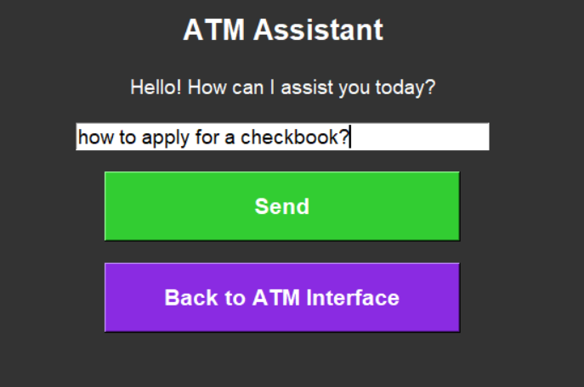
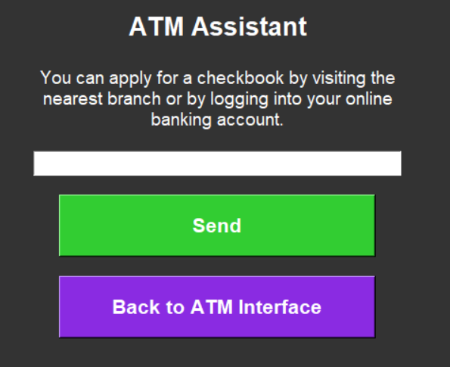
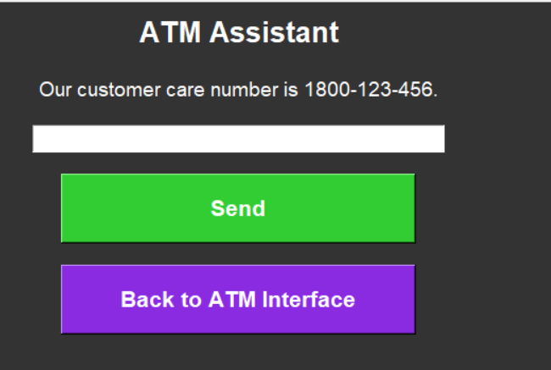
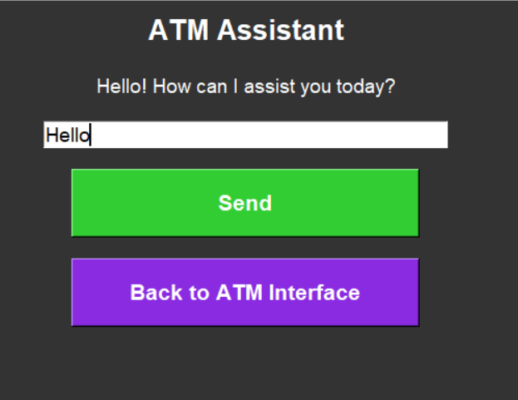

Slide 10
ATM OPERATIONS
Withdrawal: Validates the entered amount and updates the user's account balance. Logs the transaction in a user-specific text file.
Deposit: Ensures the deposited amount is valid and updates the account balance. Records the transaction in a user-specific file.
Balance Inquiry: Displays the current account balance to the user.

Slide 11
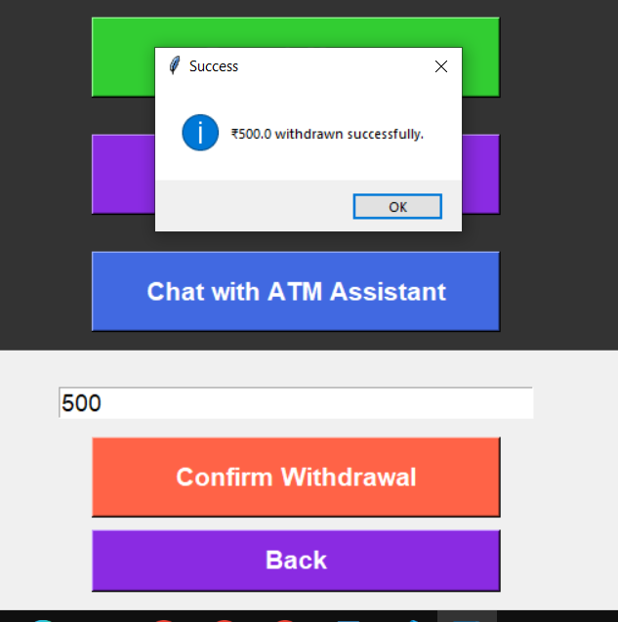
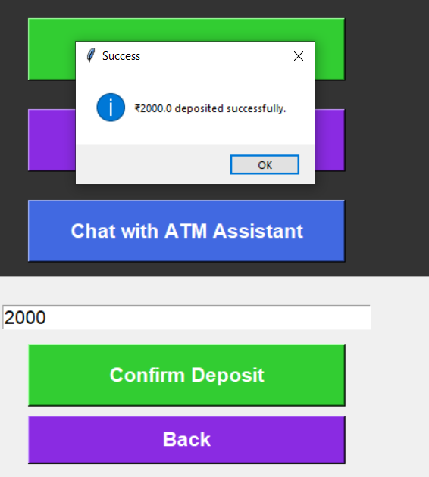
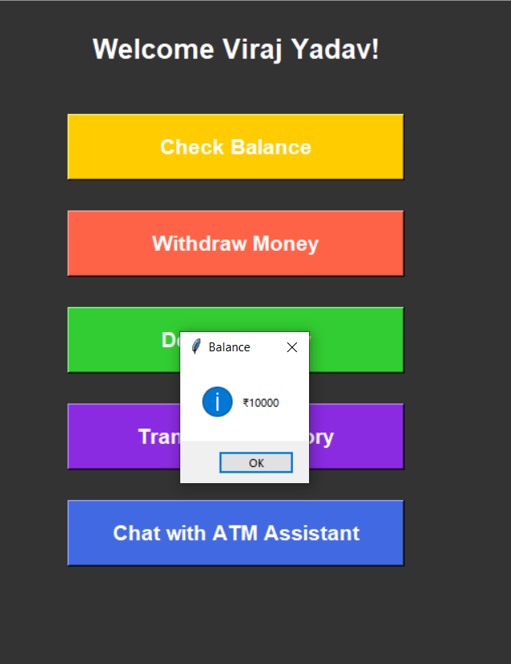

Slide 12
Transcation history Using Json
JSON Files:
Store user credentials and account balances, updated after each transaction.
Text Files:
Transaction history is logged in user-specific files ({account_number}_history.txt).
These files track deposits, withdrawals, and updated balances.

Slide 13
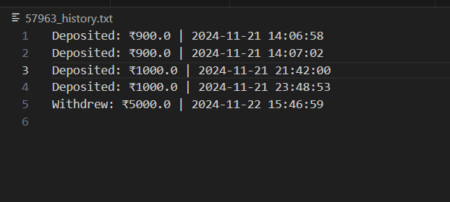
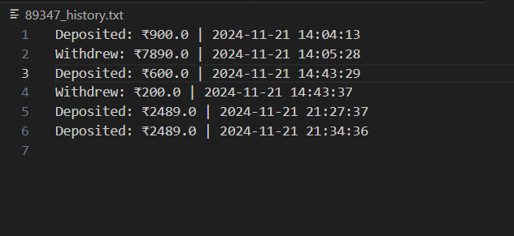
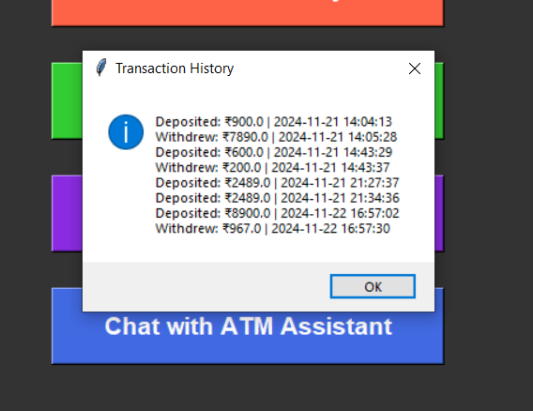

Slide 14
CONCLUSIONS AND FUTURE VISION
This ATM simulation project provides a simple, functional interface that mimics real-world ATM operations, such as login, balance checking, withdrawals, deposits, transaction history, and a basic chatbot assistant. It demonstrates the use of Tkinter for creating GUI-based applications, as well as Data persistence through JSON files which enhances reliability, while text-based transaction history ensures transparency.
Future Vision:
Potential to integrate more advanced AI and voice-based interactions for smarter and more accessible ATMs.

Slide 15
Thank you Everyone!

